Slide 1
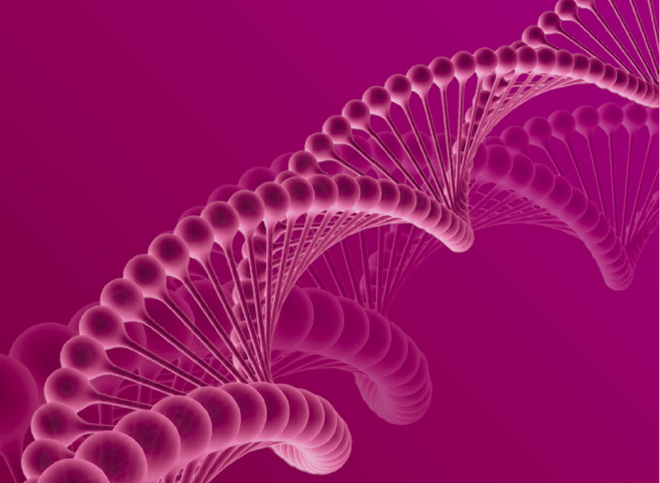
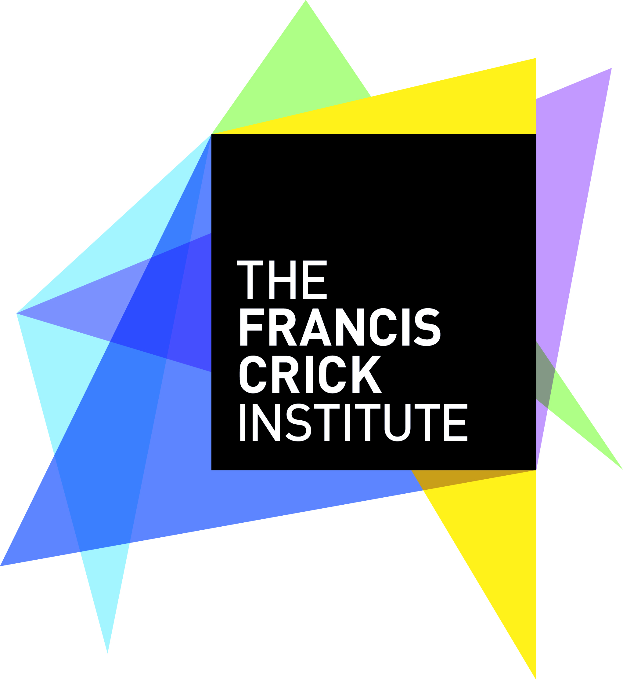
Second International Summit on Human Genome Editing
NAS/NAM/RS/ASHK
“ Introduction to Genome Editing "
Let’s Talk About Genomics and Genome Editing
The University of Hong Kong
29 November 2018
Robin Lovell-Badge
The Francis Crick Institute
1 Midland Road, London NW1 1AT, UK
And: Special Visting Professor
University of Hong Kong
robin.lovell-badge@crick.ac.uk

Slide 2
Manipulating and understanding DNA sequences
Recombinant DNA techniques in bacteria (1972 -)
DNA sequencing (1977 -)
Adding genes to mammalian cells in culture (1977 -)
Better understanding of radiation- and chemical-induced mutations in mice and in cancer treatments in humans.
Development of viruses as vectors for introducing genes into mammalian cells (1981 -)
These technologies stimulated ideas of how to treat patients with genetic disorders - “somatic gene therapy”:
Can a version of the missing gene be introduced in a way that it should be active in the relevant tissue over prolonged periods ?
Notes:
Scientists began to be able to understand and manipulate genes in the 1970’s, initially in bacteria and then in cells from mice and humans maintained in the lab. This led to understanding of the nature of genes, mutations that affect them, and it stimulated ideas of how it might be possible to treat patients with genetic disorders, so called “somatic gene therapy”. Somatic in this context refers to any cell type in the body except the “germ cells” – eggs, sperm and cells that give rise to these.

Slide 3
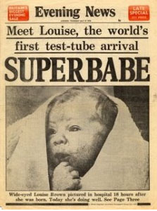


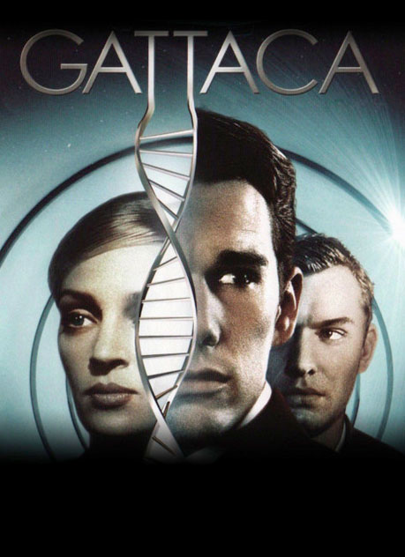
But at the same time, and almost every new technology since then, has prompted debate about the possibility of genetically modifying humans …….
“Germline or potentially heritable genetic alterations”
1978: Birth of Louise Brown,
the first IVF baby.
“Frankenstein”
Mary Shelley
1816/1818
1931/1932
Andrew Niccol
1997
Notes:
Views about this have often been influenced by dystopian views of the future that come from science fiction books and films.

Slide 4
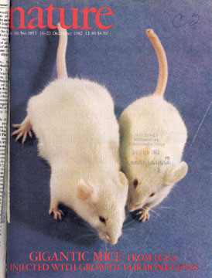
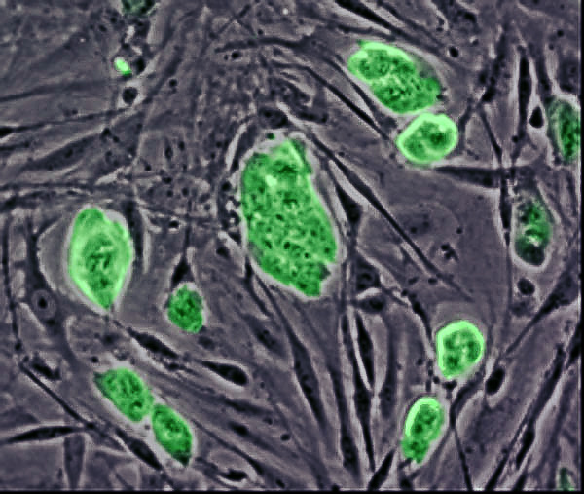
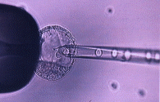
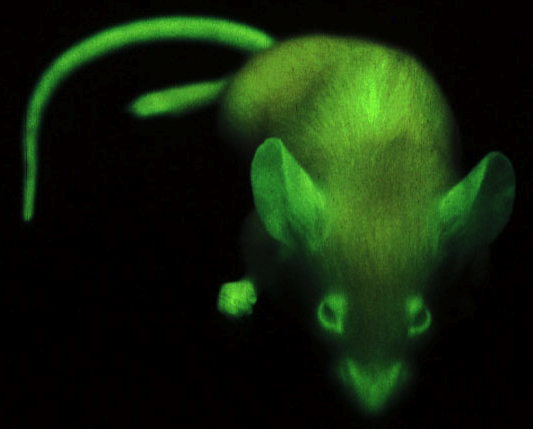
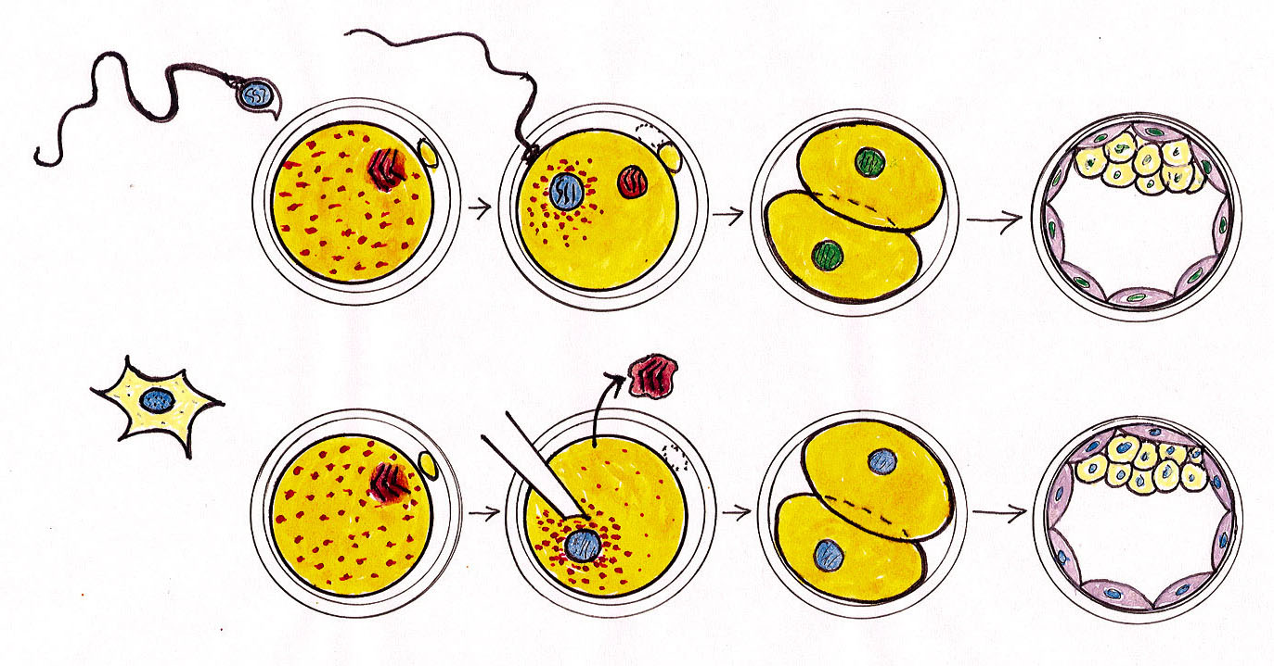
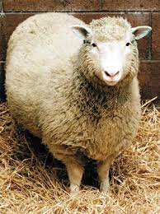
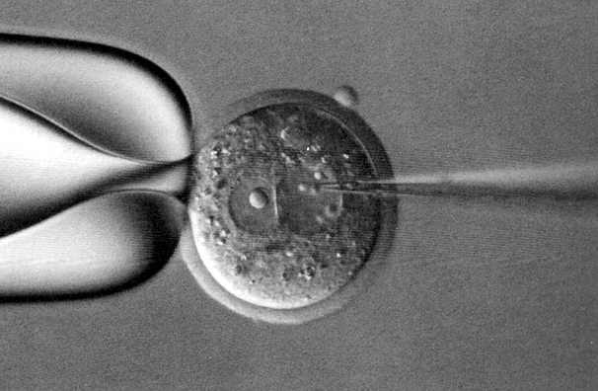
1981: Transgenic mice made by injecting DNA into fertilized eggs (zygotes). Inefficient, haphazard.
rat growth hormone transgene
1984: Mouse embryonic stem (ES) cells grown in culture are shown to contribute to fertile “chimeras” after being introduced into early embryos (chimeras are made from cells of two or more genotypes).
1989: Gene targeting via homologous recombination in mouse ES cells.
A precise method to alter genes, but very inefficient, unsafe, and not feasible in humans.
1997: Somatic cell nuclear transfer (SCNT) or “cloning”.
Genes can be altered in the cells, which can then be used to derive cloned animals. But cloning methods are inefficient and very unsafe.
Notes:
A number of methods to actually make heritable genetic alterations in mammals have been developed since the early 1980s. These began with transgenic mice made by simply injecting DNA containing a gene into the fertilized egg, where it would often be integrated into the genome of the resulting animal.
Embryonic stem cells are derived by growing cells from early (pre-implantation) embryos in culture.
A chimera is an animal made of a combination of two (or more) original embryos or of an embryo and embryo-like cells.
The cloning method takes the nucleus of a cell of an animal which is then placed within an unfertilised egg from which its own nuclear DNA has been removed. A small electric shock can then trigger the egg to develop into an embryo and, although infrequently, an animal if it is implanted into a surrogate mother.
While all these methods have been extremely valuable for science, to understand the role of specific genes and how embryos develop, etc, they are all methods that are far too inefficient and unsafe to apply to humans.

Slide 5
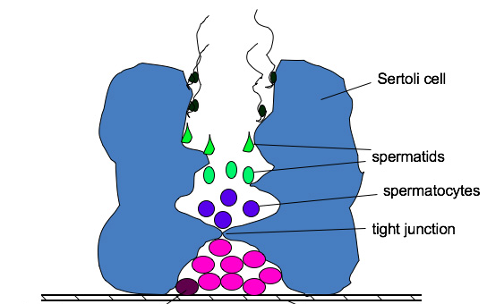
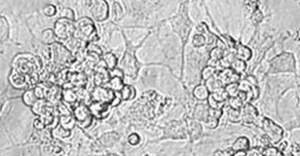
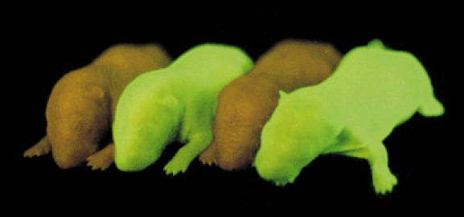
Spermatogonial stem cells as a route to altering the genome
The testis contains special stem cells that divide to make more of themselves and to cells that will give rise to sperm.
1994: Ralph Brinster developed methods to culture spermatogonial stem cells, genetically alter them, and then transplant them back into testes.
2007: Generation of genetically altered rats by this route:
It has also been shown to work in macaques
This might work in humans, but it has not yet been tried.
Notes:
The presence of these “spermatogonial” stem cells is why men remain fertile into old age. There are no equivalent stem cells in the ovary.

Slide 6
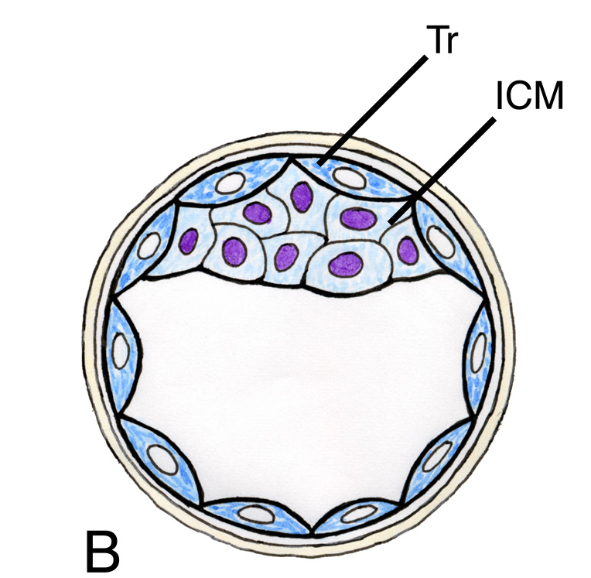
Direct reprogramming of adult somatic cells in vitro to give induced pluripotent stem (iPS) cells
Add four genes (all transcription factors) known to be important to define embryonic stem cells
OCT4
cMYC
KLF4
SOX2
Induced pluripotent stem (iPS) cells
Skin fibroblasts from tail tip
in vitro
Differentiation
.
.
in chimeras
Shinya Yamanaka and colleagues (2006)
Notes:
Induced pluripotent stem cells are very similar to embryonic stem cells, except rather than being derived from early embryos, they are made by reprogramming adult cells into cells that correspond to them.

Slide 7
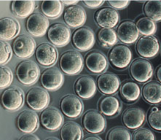
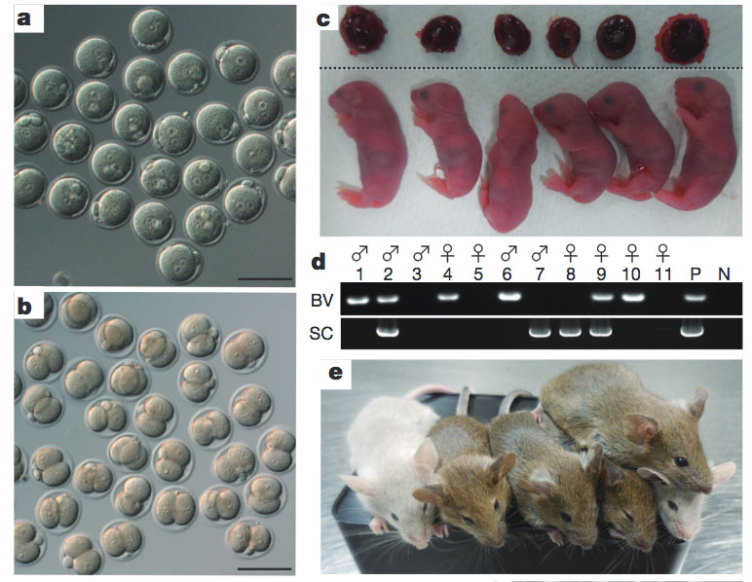
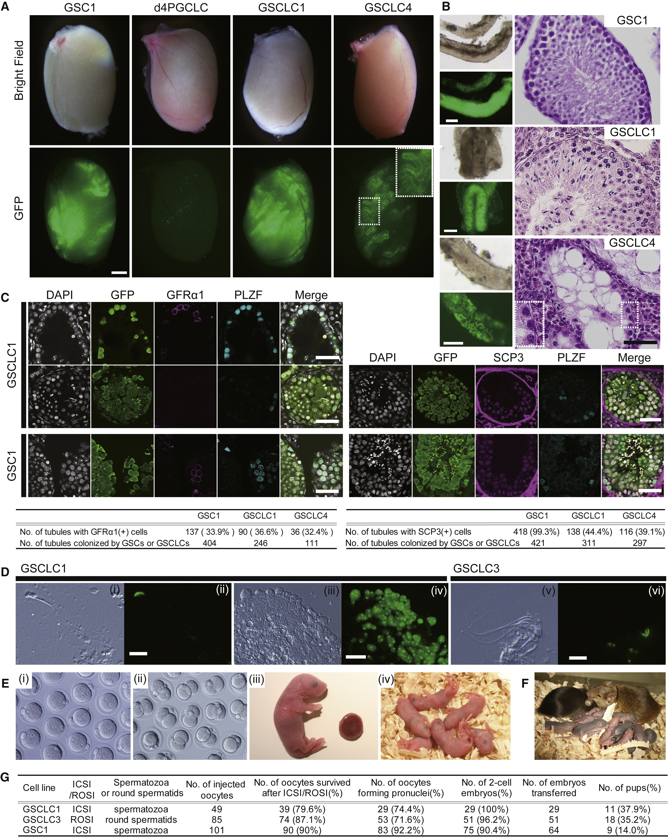
iPS cells and lab-derived gametes as a route to altering the genome
iPS cells can also give rise to “germ cells”, which, in female animals go on to give rise to eggs and in males to sperm.
2016: Mouse eggs and sperm, each capable of fertilisation, were derived from iPS cells in culture (Saitou and colleagues):
From XX iPS cells
From XY iPS cells
iPS cells have been derived from many mammals, including humans.
It may be possible to derive gametes (eggs and sperm) entirely in vitro, beginning with patient-specific iPS cells.

Slide 8
With each new method of manipulating genes in mammals, the same questions have arisen about the possibility of using them to:
Treat or avoid heritable genetic disorders.
Make “designer babies”.
Practice “eugenics”.
But always it has been possible to say that the methods are too inefficient and/or unsafe to apply to humans.
But at least two areas of science have opened up these debates again:

Slide 9
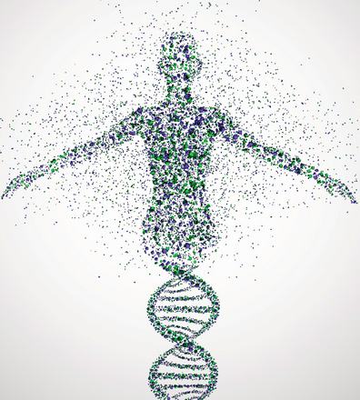
1. Over the last few years we have accumulated a lot of information and understanding of the human genome (our entire genetic code), how this varies between individuals, and
how mutations can lead
to genetic diseases.
Why not use
this knowledge
to solve our own
genetic problems ?

Slide 10
2. The precise and efficient means of altering DNA
sequences provided by genome editing methods
Genome editing generally makes use of endogenous DNA repair mechanisms
And it most often requires:
(i). “Molecular scissors”: a nuclease enzyme to make a
double-stranded (or in some methods a single-stranded) cut in DNA
(ii). “Homing device” : a mechanism to recognise specific DNA sequences – derived from DNA binding proteins such as transcription factors (ZFNs, TALENs) or complementary RNA (CRISPR)
(iii). “Template”: if more than a simple mutation is required, a DNA template with homologous arms is needed to allow homology directed repair.

Slide 11
Using CRISPR/Cas9 to make an inactivating mutation via NHEJ
protospacer-adjacent motif = PAM
CRISPR-Cas9 guide-RNA + CAS9 +
CAS9
A
G
C
T
gRNA
Double-strand break in DNA
A
G
C
T
Non-homology end-joining (NHEJ) repair
This leads to small insertions or deletions (INDELs)
A
G
G
C
T
C
2 base pair deletion
If this is in the coding region, it will prevent the protein product of the gene being made
Ku70/80-dependent
But it can also be used in some cases, e.g. with DMD, to promote skipping of an exon with a nonsense mutation to allow a functional protein to be made.

Slide 12
Using CRISPR/Cas9 to exchange sequences via HDR
CRISPR-Cas9 guide-RNA + CAS9
CAS9
A
G
C
T
gRNA
Double strand break in DNA
+
A
G
C
T
DNA template :
(single- or double-stranded)
C
A
A
G
G
C
T
T
T
T
T
Mutant PAM
A
G
C
A
T
A
A
T
A
C
C
C
A
G
A
T
T
C
G
T
T
T
Homology directed repair (HDR) leads to precise exchange of sequences
8 base pair substitution
But it can be anything from 1 bp to many 1000’s, or to insertions or deletions.
Rad51-dependent

Slide 13
Using CRISPR/dCas9 “base editing” to alter C:G to T:A
guide-RNA + dCAS9-cytosine deaminase
Cas9 with inactivated nuclease (dead.Cas9 or dCas9) linked to relevant enzyme
A
C
G
C
T
G
T
gRNA
A specific C is chemically modified to become U and then T
(no double strand break in DNA)
A
U
G
C
T
G
A
T
G
C
T
G
DNA mismatch repair mechanisms detect a problem and substitute the G with an A to restore base pairing.
T
A
G
C
T
A
Single base pair substitution
This can be used to correct or create a mutation
About 50% of simple inherited diseases are due to single base pair substitutions

Slide 14
Some advantages of CRISPR/Cas9 methods
CRISPR/Cas9: Simple to make components: guide RNAs, Cas9, and DNA templates
Relatively simple to introduce these into cells and early embryos.
Highly specific Few if any off-target events
Highly efficient But mosaicism ?
Ability to “multiplex”
Versatile:
- Alterations to DNA: including “indels” and deletions, insertions or substitutions from single base-pairs up to many kilobases.
- Cas9 DNAse activity can be mutated and other proteins linked to it to permit “base-editing”, but also by using transcriptional activators or repressors or chromatin modifiers, it is possible to manipulate specific gene activity without altering DNA.

Slide 15
The CRISPR/Cas9 methods are now sufficiently precise and efficient that the old arguments, about the methods of altering DNA being too unreliable and unsafe to use with humans, may well no longer apply.

Slide 16
Three major applications of genome editing with human cells
RESEARCH
Basic and “pre-clinical” research (purely laboratory) work on cells and tissues
CLINICAL
Somatic (non-heritable) interventions in patients to treat or prevent disease
Germline (potentially heritable) interventions to treat or prevent disease

Slide 17
Experiments in vitro to understand human biology
The role of specific genes can be studied in different contexts.
The methods can be used to make a mutation or correct a mutant gene in patient tissue-specific stem cells or iPS cells.
Such cells can also be used for screening drugs.
Already common with a variety of human cells systems in vitro:
Organ-specific stem cells, e.g. neural stem cells, gut stem cells, which can be used to make “organoids”.
Embryonic Stem (ES) cells and induced pluripotent stem (iPS) cells, which can be differentiated in vitro to:
- Specific cell types: neurons, primordial germ cells, etc.
- Complex tissues: cortical brain structures, optic cups,
kidney-like structures, etc.
Why not use the techniques to study preimplantation embryos and other germline cells ………………

Slide 18
Experiments in vitro to understand human biology
The genome editing techniques are now widely used around the world with a variety of human cell systems in the lab to understand the role of specific genes, how they lead to disease, and to screen for drugs, etc.
These include:
Simple cell cultures
Organ-specific stem cells, e.g. neural stem cells, gut stem cells.
ES and iPS cells, which can be cultured in vitro to give many specific cell types and even complex tissues, including brain structures, optic cups, kidney-like structures, etc.

Slide 19
Human embryos need OCT4 to correctly form a blastocyst
The genome editing techniques are now widely used around the world with a variety of human cell systems in the lab to understand the role of specific genes, how they lead to disease, and to screen for drugs, etc.
These include:
Simple cell cultures
Organ-specific stem cells, e.g. neural stem cells, gut stem cells.
ES and iPS cells, which can be cultured in vitro to give many specific cell types and even complex tissues, including brain structures, optic cups, kidney-like structures, etc.
The techniques are also being used to study early human embryos in culture
Notes:
Most of what we know about early embryo development in mammals comes from studies using mice. However, humans are not mice and it is very clear that the genes important in early mouse embryos cannot be playing the same function in the human because the activity of these genes, whether they are expressed or not, is quite distinct.
The control, un-edited embryo is developing normally, but the embryo that has genome edited mutation in the gene OCT4 fails to make a normal blastocyst. This experiment revealed that OCT4 has a much earlier and broader role in human embryos compared to the mouse, where Oct4 mutant embryos will develop normally over the equivalent period.

Slide 20
Clinical applications: Somatic Gene Therapy
Genome editing is a relatively new tool for gene therapy
Advantages over old methods:
Corrects the defective gene, which will be active at the correct levels, rather than introducing an extra copy of the gene, which will insert at random in the genome and may not be correctly regulated.
Approaches for somatic interventions:
Editing cells outside the body (ex vivo) and reinserting them:
editing blood cells for treatments of cancer (CAR-T cells) or HIV
editing blood cells for sickle cell disease, thalassemias
Editing cells directly in the body (in vivo), with e.g. viral or particle delivery (technically more challenging):
editing liver cells for metabolic diseases or haemophilia
editing muscle cells for muscular dystrophy
mutating human papilloma virus in epithelial cells to reduce cancer risk

Slide 21
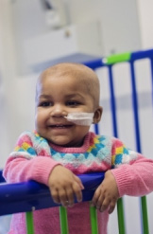
Somatic gene therapy in humans using genome editing:
ZFNs to mutate the HIV receptor, CCR5 in AIDS patients
Layla Richards, with acute lymphoblastic anemia
(ALL), was the first in the world to be given
TALEN genome-edited immune cells
(CAR-T cells) to treat an 'incurable' cancer.
CRISPR/Cas9 for CAR-T cells for small cell lung cancer:
Trial in China just starting.
Sickle cell and β-thalassemia: Preclinical data is very promising.
With all the above, the genome editing is carried out ex vivo.

Slide 22
What about in vivo somatic gene therapy via genome editing ?
Challenges include:
Efficient delivery methods
Capacity of viral vectors: - Adenovirus Associated Viral (AAV) vectors
- Adenoviral vectors
Off target events: - Even if the frequency is low, the number of
cells that need to be targeted is very high.
(But benefit versus risk ?)
Immune responses: -To Cas9 and/or viral vectors
Moving from preclinical (cell lines and animals) to clinical “trials”.
But some preclinical data looks promising:
CRISPR/Cas9-mediated gene editing ameliorates neurotoxicity in mouse model of Huntington’s disease. Su Yang, et al. JCI. (2017)
Gene editing restores dystrophin expression in a canine model of Duchenne muscular dystrophy. Amoasii et al. (2018).

Slide 23
Germline (potentially heritable) genome editing to treat or prevent disease
The human genome is not static; changing with ~40 to 80 base pair substitutions and 4 or 5 small insertions or deletions (INDELS) each generation due to de novo germline mutations.
Given the size of the genome, and that many of these mutations will be silent, this degree of change seems small.
Nevertheless, it has contributed to human variation and, consequently, to selection for specific traits during our evolution: in response to changing climate, food, and disease.
It also contributes to the burden of genetic disease, leading to:
Miscarriage and prenatal lethality
Early postnatal lethality
Other congenital diseases
Lifetime “disabilities’
Cancer, degenerative and late onset diseases

Slide 24
What can we do about inherited genetic disease ?
How about deliberately altering our genes and genomes ?
Can we avoid genetic disease in our children ?
In theory, if the techniques are both safe and efficient.
But certainly not always – we can do little about spontaneous (de novo) mutations.
Could we genetically enhance our children ?
Can we alter our own evolution ?
Should we do any of these ?

Slide 25
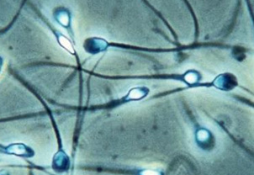
Potentially Heritable Genome Editing
Possible Methods: 1
Editing cells that give rise to sperm, such as spermatogonial stem cells, or perhaps via iPS cells and in vitro-derived gametes to eggs or sperm.
This allows verification of the edits before embryos are made.
This has been done using spermatogonial stem cells in mice, rats and macaques; and via ES and iPS cells in mice.
Correction of a genetic disease by CRISPR-Cas9-mediated gene editing in mouse spermatogonial stem cells. Wu et al. (2015) Cell. Res. 25, 67-79.
Targeted Germline Modifications in Rats Using CRISPR/Cas9 and Spermatogonial Stem Cells. Chapman et al. (2015) Cell Rep. 10, 1828-35.

Slide 26
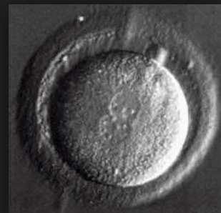
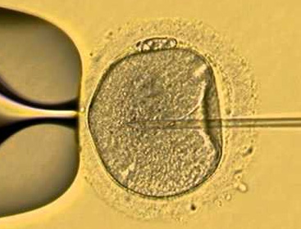
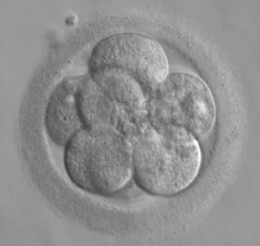
Heritable Genome Editing
Possible Methods: 2
Editing the fertilised egg (zygote)
It will be more difficult to verify the edits. Unless these are known to be close to 100% reliable, this would require Preimplantation Genetic Diagnosis (PGD)
But currently, the methods are not quite efficient enough and there is a risk of mosaicism, where not all cells in the embryo carry the desired genetic alteration.
If this is the case, PGD becomes unreliable.
Notes:
PGD involves taking one or a few cells from the early embryo and carrying out a genetic test on these cells. It is already used clinically to allow parents to choose embryos to implant to avoid a known genetic disease.

Slide 27
All three main genome editing approaches have now been used in early human embryos
CRISPR/Cas9-mediated gene editing in human zygotes using Cas9 protein.
Tang, L., .. Lui, J. (2017). Mol Genet Genomics. 292, 525-533
Correction of a pathogenic gene mutation in human embryos.
Ma, H., … Mitalipov, S. (2017). Nature. 548, 413-419.
HDR
Genome editing reveals a role for OCT4 in human embryogenesis.
Fogarty, N. et al,.. Niakan, K. (2017). Nature. 20 September.
NHEJ
Correction of β-thalassemia mutant by base editor in human embryos.
Liang, P. et al, .. Huang, J. (2017). Protein and Cell. 27 September.
Correction of the Marfan Syndrome Pathogenic FBN1 Mutation by Base Editing in Human Cells and Heterozygous Embryos.
Zeng, Y., … Huang, J. (2018). Mol. Therapy.
Base
editing

Slide 28
Heritable Genome Editing
The methods are still not safe to use: more research is needed.
However, it seems inevitable that genome editing via gamete precursors or early embryos will be made to work efficiently and probably safely.
Interest is driven by the thousands of inherited diseases.
It would allow individuals to have genetically related children without passing on a known risk of genetic disease.
PGD
In many cases, PGD or prenatal diagnosis with selective termination are alternatives.
But PGD is often inefficient and it is not always possible

Slide 29
PGD is often inefficient and it is not always possible :
Where mutations affect fertility: too few embryos and patients might have to go through many rounds of treatment to find a disease free embryo, if ever.
For “saviour siblings”, or where more than one harmful mutation or variant allele makes the probability of finding a “disease-free” embryo very low.
The genome editing methods may turn out to be more efficient and perhaps more reliable than PGD.
For some people they may be more acceptable, because embryos are “rescued”, not destroyed.
Rare individuals homozygous for any dominant version of a gene that leads to disease, such as Huntington’s disease.
Rare occasions where both parents are homozygous for a recessive mutation leading to a genetic disease.
In all these situations, genome editing may be the only way to retain a genetic connection to the child.

Slide 30
Which gene variants (mutant alleles) might be relevant for correction via germline genome editing ?
It is difficult to focus on specific genes:
Common diseases, such as:
Cystic Fibrosis, Duchenne Muscular Dystrophy, familial
hypercholesterolemia, sickle cell disease, beta-thalassemia, Spinal Muscular Atrophy ?
Diseases that are generally rare, but occur at high frequencies in specific populations, such as:
Tay Sachs, Huntington’s, etc.
But there are >10,000 single gene disorders !
Perhaps it will depend on who is standing in front of the clinician asking for help to have a healthy, genetically related child.
As our ability to treat patients improves, including conventional methods and somatic gene therapy, there will be more patients surviving to reproductive ages. They will not want their children to inherit alleles associated with genetic disease.

Slide 31
The methods are still not safe to use !!
Much more research is needed.
However, it seems inevitable that genome editing via gamete precursors or early embryos will be made to work efficiently and, probably, safely.

Slide 32
Enhancement – somatic or germline
Making changes beyond ordinary human capacities; or anything outside of treatment/prevention of disease and disability
Significant public concern about fairness, if available only to some people, and about creating pressure to seek out enhancements
But many other kinds of enhancement are tolerated or encouraged: Nutrition, education, cosmetic procedures
Potential for uses of genome editing beyond therapy
For example: curing muscular dystrophy versus becoming stronger than normal.
But the range of possible uses of approved therapies for enhancement seems limited

Slide 33
Enhancement – somatic or germline
Making changes beyond ordinary human capacities; or anything outside of treatment/prevention of disease and disability
Significant public concern about fairness, if available only to some people, and about creating pressure to seek out enhancements
But many other kinds of enhancement are tolerated or encouraged: Nutrition, education, cosmetic procedures
Potential for uses of genome editing beyond therapy
For example: curing muscular dystrophy versus becoming stronger than normal.
But the range of possible uses of approved therapies for enhancement seems limited
Enhancement using genome editing is unlikely to offer benefits sufficient to offset risks at this time

Slide 34
Continuing, but key questions :
What uses for genome editing in human clinical applications
might be permissible ?
What are the safest methods ?
Social justice: how can we ensure access of the applications
to all who may need them ?
How can we obtain good understanding of the views of patients and their families ?
How can we have good regulation and good oversight ­ which, if done well should avoid trivial, unjust, or other uses that society as a whole deems unacceptable ?
How can we avoid the problems associated with “rogue” clinics offering unsafe, untested, genome editing methods to ‘treat’ or avoid genetic disease or for enhancements – a problem for both somatic and germline genome editing ?

Slide 35
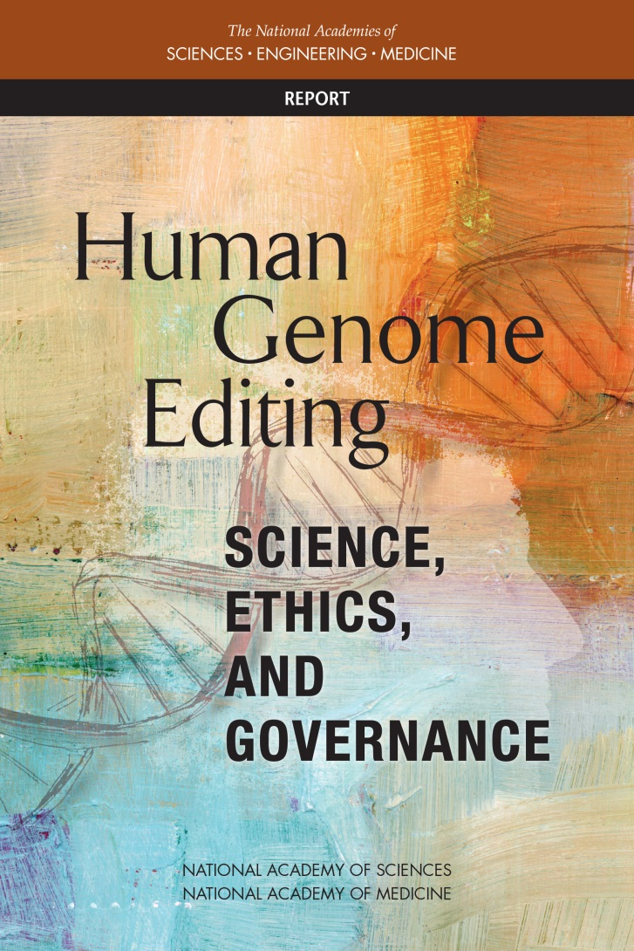
National Academies of Sciences and National Academy of Medicine
Report, Released on 14 February 2017
Study Committee co-chairs:
R. Alta Charo, J.D.
and Richard O. Hynes, PhD
nationalacademies.org/gene-editing/consensus-study

Slide 36
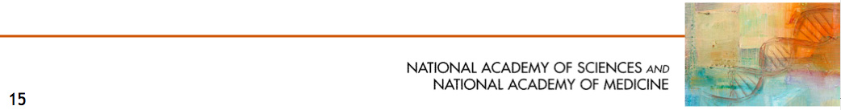
Heritable Genome Editing Clinical Trials
The NAS Report was framed with a clinical perspective, which allows an approach based on risk versus benefit.
Caution is needed, but being cautious does not mean prohibition.
Heritable genome editing research trials might be permitted, but only:
- After more research to meet existing risk/benefit standards,
- under strict oversight, and
- if they are restricted to specific set of criteria.

Slide 37

Overarching Principles for Governance of Human Genome Editing
Promoting well-being
Due Care
Transparency
Responsible Science
Respect for Persons
Fairness
Transnational Cooperation
Any nation considering governance of human genome editing can incorporate these principles—and the responsibilities that flow from them—
into its regulatory structures and processes.
Embedded within international conventions for protection of human rights & for research with human subjects and clinical care
Notes:
The committee developed a set of principles to be incorporated by any nation considering governance of human genome editing and its regulatory structures and processes.
HIGHLIGHT international context, cue Robin or Duanqing for comment if necessary

